Slide 1
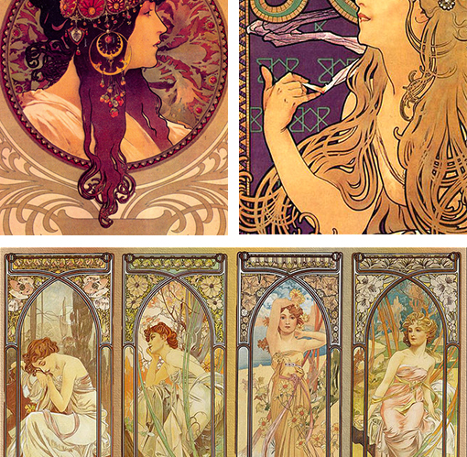
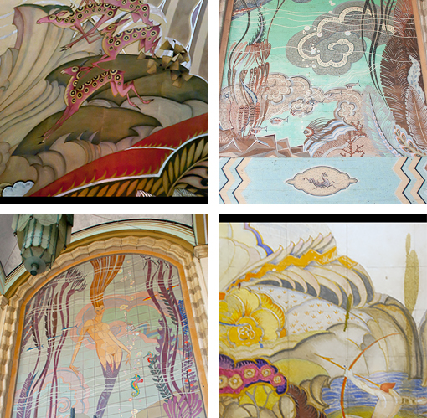
Art Nouveau I
Curvilinear, with warm colors. Flowing, unrealistic feel. By Alphonse Mucha.
Variety of colors, retaining curvilinear forms. By John Gabriel Beckman.

Slide 2
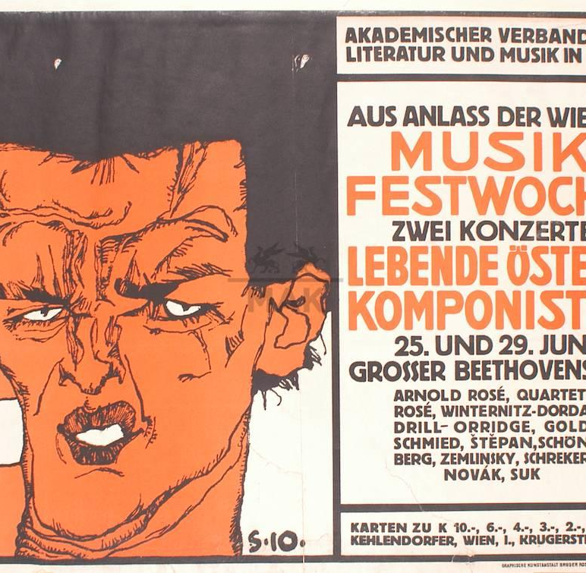
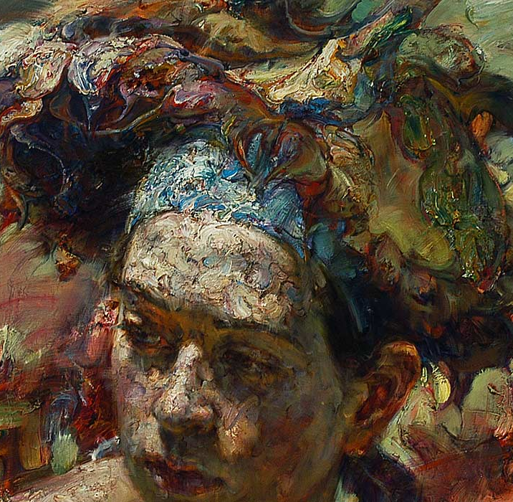
Art Nouveau II
Expressionism: Musik Festwoche. Stark contrast between colors. by Egon Schiele
Modern Expressionism: Usage of multiple colors, emphasis on facial expression. By Victor Wang

Slide 3
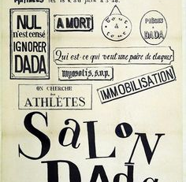
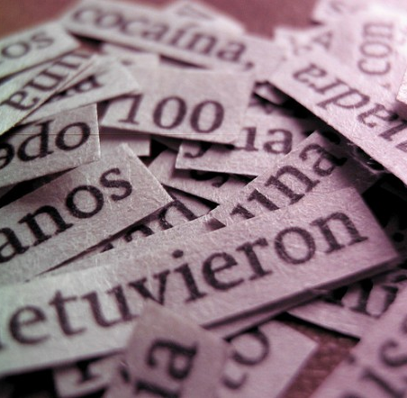
Dada
Salon Dada: Tristan Tzara – Disorganized, unorderly, and almost unrelated concepts
Image by Pablo Macalupú: Similarly messy. Compilation of different Spanish words.

Slide 4
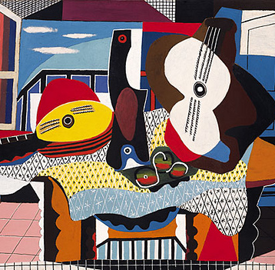
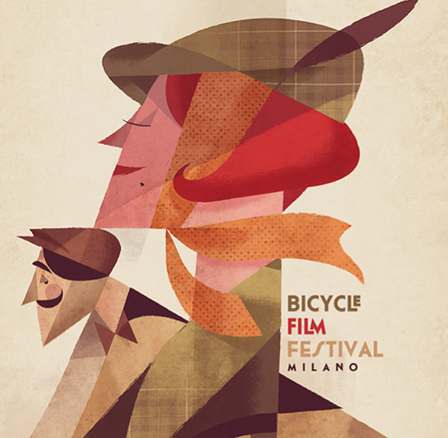
Cubism
Mandolin and Guitar (1924) by Pablo Picasso – lively colors, dissection and reorganization of forms
Milano Film Festival by Riccardo Guasco – Lively colors, geometric themed

Slide 5
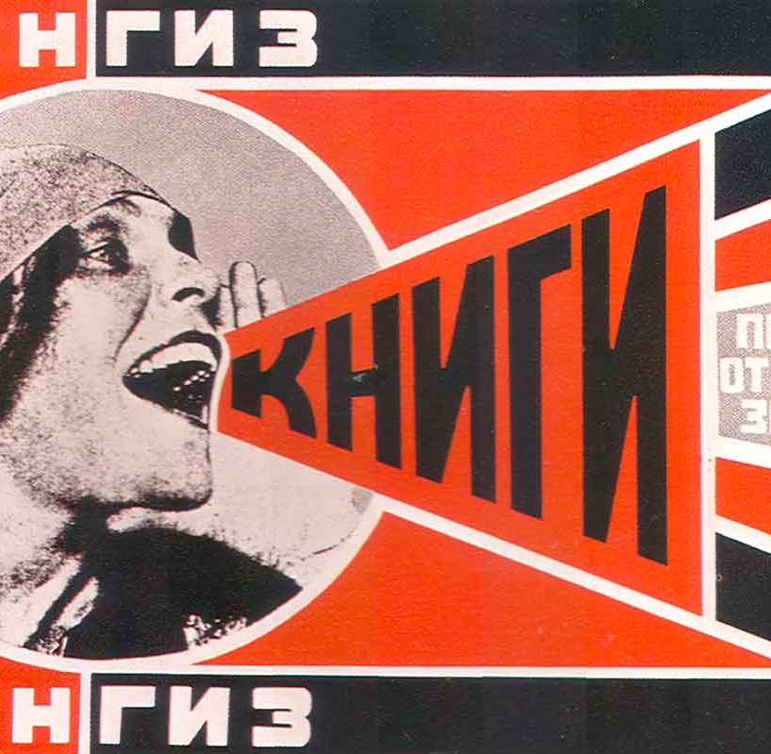
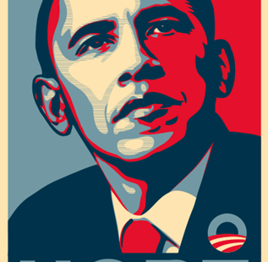
Constructivism
Alexandr Rodchenko – Geometric style, stark color difference, nationalistic colors
Shepard Fairey – Obama’s Hope Poster: Nationalistic colors

